Slide 1
Resource Capacity Planning

Slide 2
Topics
Resource Management Overview
Resource Management Process
Design of Our Tool
Demonstration
Summary & Next Steps

Slide 3
What is Resource Management?
Benefits:
Resource Visibility
Increase Business Value
Save Time and Money
Increase Project Success Rates
Accommodate Demand
Employee Satisfaction
Resource management is the efficient and effective deployment and allocation of an organization’s resources when and where they are need.

Slide 4
Resource Management Challenges
Resource Visibility
Non/Support Project Workload
Resource Tracking
Manual Reporting
Resource Focus

Slide 5
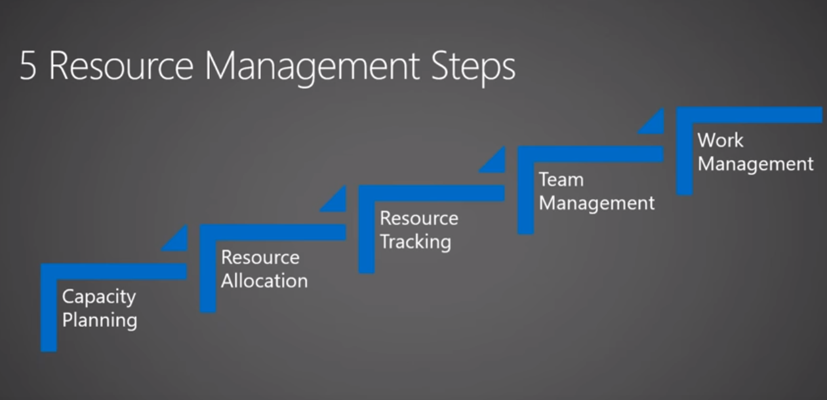

Slide 6
Resource Management “Musts”
Assess Readiness
Understand Organization Maturity
Understand the Environment
Build a Resource Management Road Map
Define Your Process First

Slide 7
How the Current System in Working Today

Slide 8
Currently each LOB/TM using Excel to manage the Resource
Problems with current system
No visibility of resource capacity
Time consuming
Visibility & Insight
Governance
Strategic alignment of projects to organication objectives

Slide 9
Transformative options
Demonstration

Slide 10
Proposed Solution
Embedded Process
Central data store
Pull all upstream SORs data
Actionable Intelligence
Resource Engagements
- high level forecast -
Total Resource
Requirement
Schedules
- detailed to support execution -

Slide 11
Visual Resource Planning within Projects
Schedule resources and equipment with a bird’s eye view of your team’s allocation
Screen shot here gantt

Slide 12
Resource Forecast Planning
Make resource allocation decisions on the fly.
Proactively solve scheduling conflicts with a dynamic timeline that visualizes the resource schedule for the organization.
Balance skills and availability with a centralized view to identify who has availability.
Add, edit and delete assignments
Screen shot booking

Slide 13
Resource Search Ability
Across the lob level a TM can search for the availability resource
Best Match
Relevant Match
Screen shot

Slide 14

Summary
Resource management is a critical success factor for PPM success
Approach and processes should align with organizational readiness and maturity
High-level capacity planning is a good place to start
More detailed resource allocation can follow as ready or needed
Our Solution provides a great platform for all Resource capacity planning capabilities

